Slide 1

SENG365 Web Computing Architecture: Overview to web clients
Austen Rainer Course Coordinator austen.rainer@canterbury.ac.nz 202, Erskine Building

Slide 2



Teaching team
Tom Young
The Mastermind
Lecturer, Term 3
Ashley Williams
The Explosives Expert
Tutor
James Watson
The Getaway Driver
Tutor
Austen Rainer
The Enforcer
Course Coordinator & Lecturer, Term 4

Slide 3
News
Feedback on mid-semester test today, and return of test scripts
Feedback on Assignment 1 next week
Reminder: Thursday 19 October – special lab session (Assignment 2)
You must attend

Slide 4
What did you study in Term 3?
A brief review to help us get back into the subject

Slide 5
Reminder: The story so far…
Lectures
Labs
What happens on the server-side? For example:
HTTP requests & responses
APIs & API-driven design
The server itself
e.g. Node.js & express
Data persistence e.g. MySQL
JavaScript
Node.js + express
Data persistence
APIs
Additional Lab/s
OWASP Security

Slide 6
… the story continues in Term 4: What happens on the client side? Rather a lot, actually.
Topics (indicative)
Labs
Web client technologies
HTML, CSS, JavaScript
Libraries e.g. jQuery, Bootstrap,…
Frameworks e.g. Vue.js
AJAX, CORS, …
Single Page Applications
Progressive Web Applications
Design patterns
Reactive Programming
Testing of web clients
To complement the lectures
Introduction to client-side
Vue.js
Additional Lab/s
Testing
Reactive programming
Progressive web apps

Slide 7
Term 4: the weeks ahead (indicative)
# Week | Labs
7 Overview to web clients | Overview to web client technology
8 Single Page Applications, & Frameworks | Vue.js
9 TBC: AJAX,CORS, … | Vue.js
10 TBC: Testing | Vue.js
11 TBC Progressive Web Applications Thursday: SENG402 Presentation Friday: SENG302 Showcases | Work on Assignment 2
12 Assignment 2 Lab Activity Compulsory attendance | Attend lab to test others’ clients (anonymously)

Slide 8
This week
In the lecture
In the lab
(Admin)
(Brief review of Term 3)
Web computing architecture
Client-side
HTML
CSS
JavaScript
Bringing it together
Feedback on Assessment/s
Mid-semester test
Overview to web clients

Slide 9
Web Computing Architecture

Slide 10
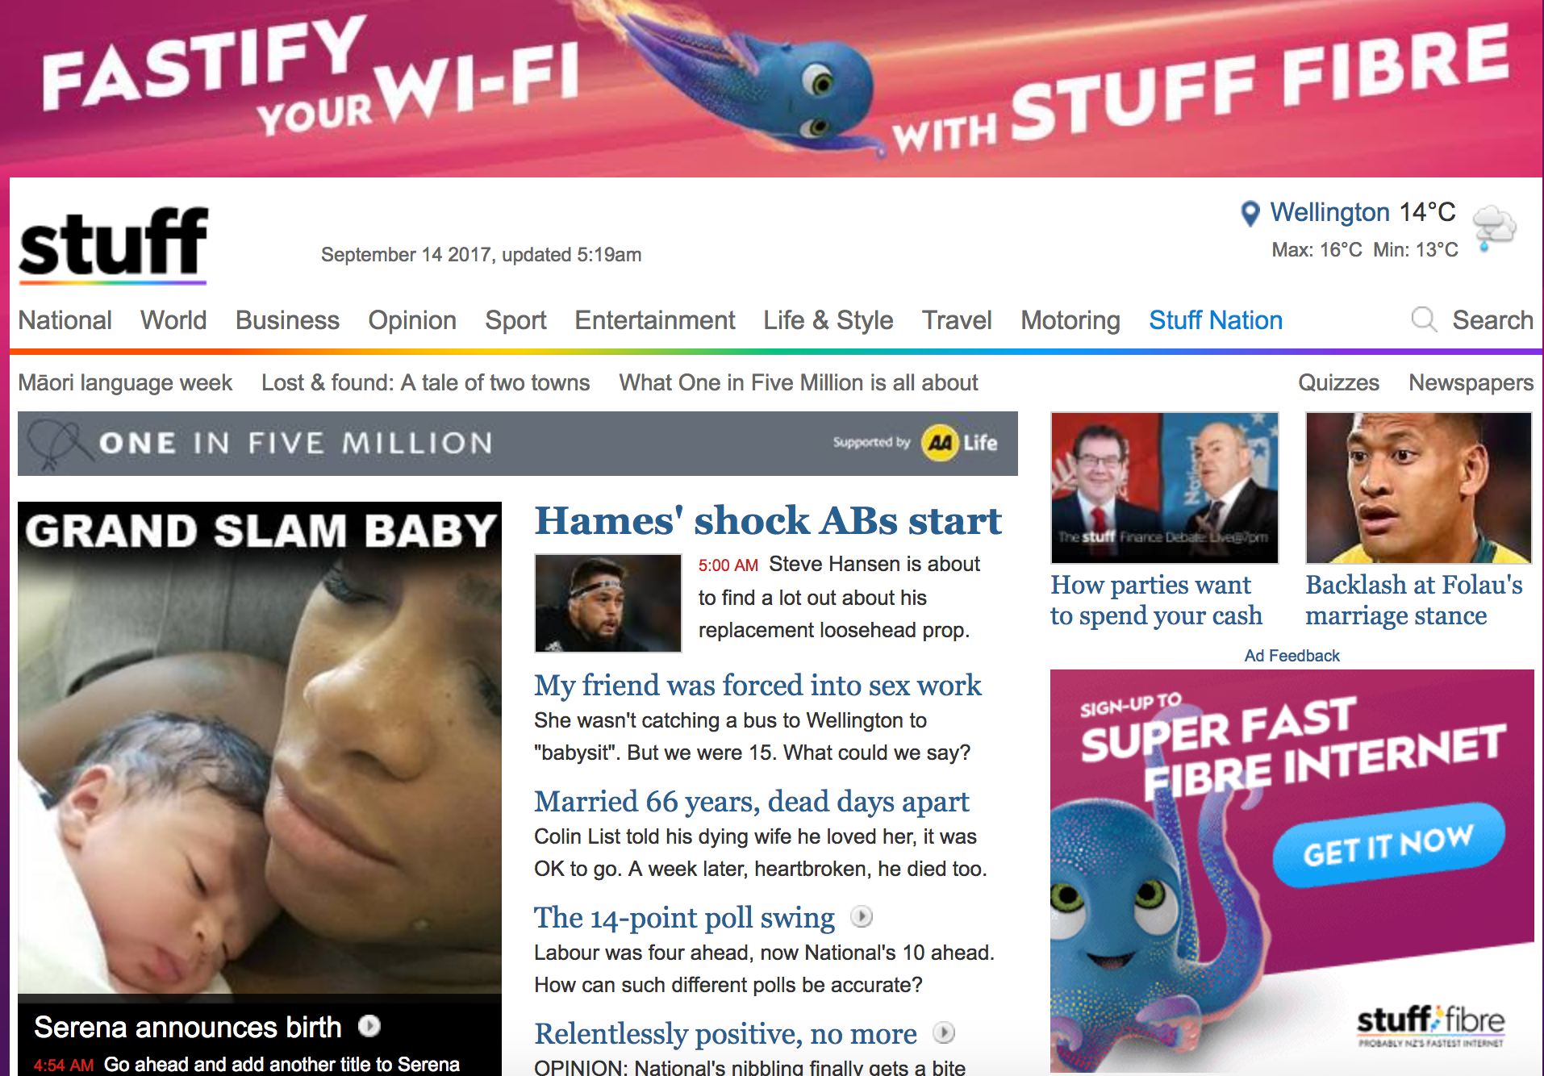
What is the user experience in the browser?
What content is shown to the user in the browser?
https://www.stuff.co.nz/
Notes:
What kinds of content ‘appear’ in the browser? Think in terms of:
What the user sees? For example, text.
How that content is described e.g. in the view source option
How is that content presented in the browser?
Colours, styles etc

Slide 11
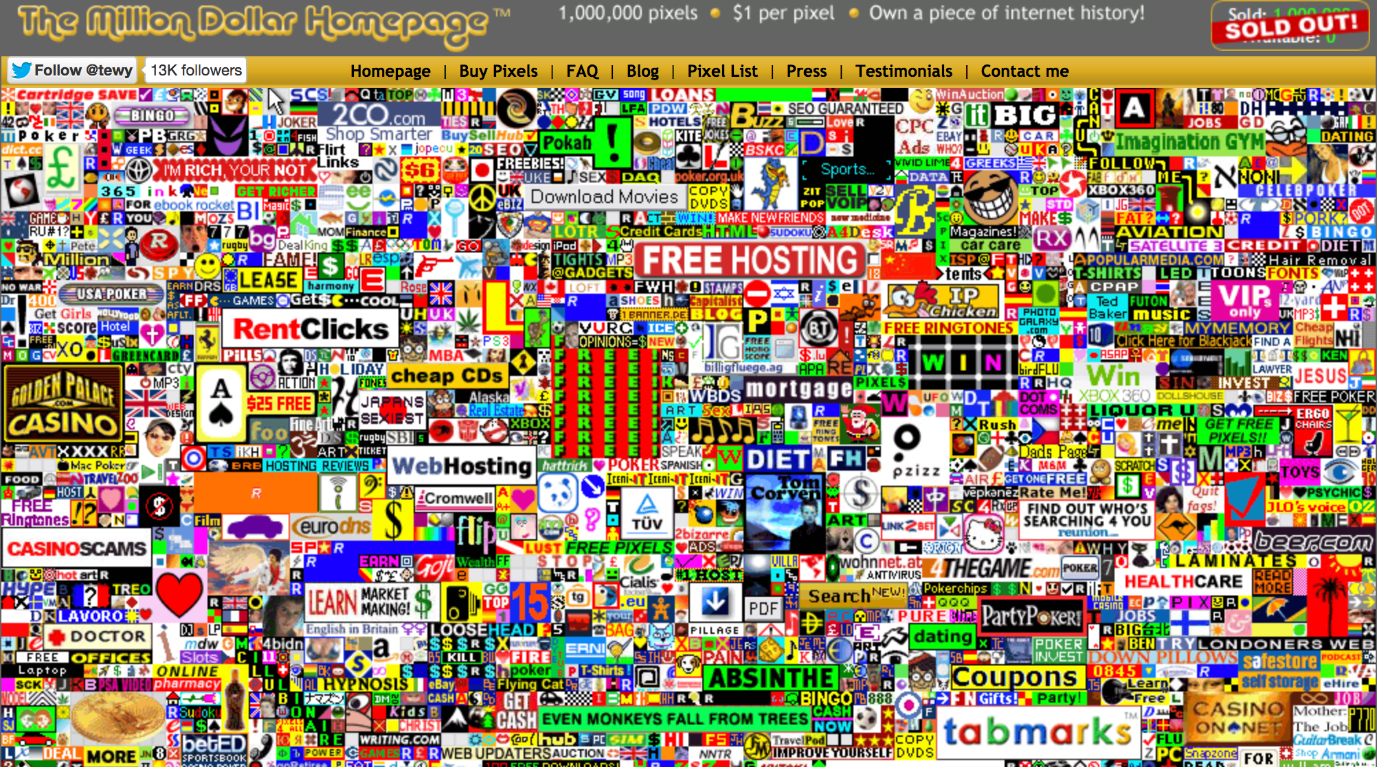

Slide 13

HTTP
HTML
Express
Data JSON, XML,…
Queries (SQL)
CSS
APIs
API
Node.js
Results (data)
JS
Resources HTML
CSS
JavaScript …
Relational Not-only relational Object
User
Client
Server
Database
Human
Machine
Machine
Machine

Slide 14
Questions
What kinds of data are sent from server to client?
(Not protocol (HTTP), but data.)
What kinds of data are sent from client to server?
URLs for API endpoints
What else?
Why and how have things changed over time, since 1990s?
Why have these kinds of data changed over time?
How have the kinds of data changed over time?
How have the ways in which data is sent changed over time?
What kinds of processing are happening on the client side?
Where do (asynchronous) events fit in here?
(Data may be different to content – I’ll explain later.)
Notes:
What kind of data is sent from server to client?
(Not protocol (HTTP), but content.)
What kind of data is sent from client to server?
(Not protocol (HTTP), but content.)
Why have the kinds of data being sent changed over time?
User experience
Security
Functionality
Performance
Reliability
How have the kinds of data being sent changed over time?
Once upon a time: Static HTML, with data embedded into the HTML on the server side.
‘Application’ (of HTML, CSS, JavaScript) downloaded to the client; and then an exchange of data between client and server
How have the ways in which data is sent changed over time?
Increasing use of AJAX, in which the application downloaded data behind the scenes, which means (for example) many HTTP GET requests.
Change in the format of the data e.g. from XML to JSON. JSON is (much more) concise/efficient.
Increasing use of micro-services i.e. pulling data from various sources
Increasing use of CDNs
Where do events fit in here?

Slide 15
A peep inside a web client (browser)
Largely standardised across browsers
HTML + CSS
DOM + CSSOM
Libraries & Frameworks
JavaScript
APIs e.g. AJAX
Other stuff
Device | platform

Slide 16



Overview to the main client-side technologies

Slide 17
Client-side: HTML

Slide 18
What is HTML?
“HTML (HyperText Markup Language) is the most basic building block of the Web. It describes and defines the content of a webpage. Other technologies besides HTML are generally used to describe a webpage's appearance/presentation (CSS) or functionality (JavaScript).”
(https://developer.mozilla.org/en-US/docs/Web/HTML)
Notes
Be careful about the difference between content and data.
Also, be careful about your concept of a webpage. What constitutes a ‘web page’ has changed over time.

Slide 19
Yeah, okay, but what is HTML
HTML is a declarative ‘language’, comprising:
a declaration of a document type (HTML), together with a
hierarchical structure of (nested) HTML elements, where
elements are identified by tags, and
elements typically contain some kind of content (to display), and where
elements may have attributes, in which
attributes define characteristics of elements,
attributes often have values (for the characteristics),
attributes allow cross-referencing to CSS and JavaScript, and
attributes may be custom-defined.
(There are new elements in HTML5.)

Slide 20
Basic example of HTML page
<!DOCTYPE html> <html lang="en"> <head> <meta charset="UTF-8"> <title>A title</title> </head> <body> </body> </html>
HTML comprises:
Document type declaration
Elements, organised into a hierarchy, e.g.
<html>
<head>
<body>
Attributes of elements, with values
lang=“en”

Slide 21
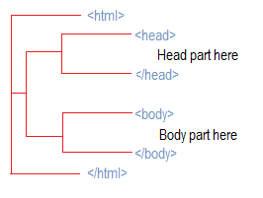
document
http://www.corelangs.com/html/introduction/img/html-page-structure.png

Slide 22
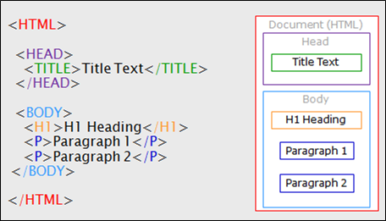
http://help.madcapsoftware.com/flare2017r2/Content/Resources/Images/Flare/page_structure_example.png

Slide 23
HTML elements
For example, if we wanted to write the following on a web page:
We need more Māori students taking software engineering.
<p>We need more Māori students taking software engineering.</p>
Content
Opening tag
Closing tag
Element

Slide 24
HTML elements & their attributes
For example, if we wanted to write the following on a page:
We need more Māori students taking software engineering.
<p> class=“aim” We need more Māori students...</p>
Name
Value
Attribute

Slide 25
Nested HTML elements
For example, if we wanted to write the following on a web page:
We need more Māori students taking software engineering.
<p>We need more <strong>Māori</strong> students...</p>
Nested element
Content
Opening tag
Closing tag

Slide 26
One way to change HTML content: JavaScript
HTML: before
<p id=“four”>Oh, cruel world.</p>
JavaScript
document.getElementById(”four").innerHTML = ”Hello world!";
HTML: after
<p id=“four”>Hello world!</p>

Slide 27
Custom attributes (we’ll come back to this)
You can define your own attributes for elements
HTML5 offers data-* attribute
Where * is a string of characters of your choice
But potential for name clashes with other JavaScript libraries
I define data-student in my student.js library, and
You define data-student in your super-student.js library
Vue.js and Angular.js use custom-defined attributes as part their two-way binding ‘magic’
Angular has ng-* attributes
Vue has v-* attributes

Slide 28
Pointers elsewhere
Validate your HTML at:
https://validator.w3.org/
Further information on new HTML5 elements:
https://developer.mozilla.org/en-US/docs/Web/Guide/HTML/HTML5

Slide 29
Client-side: CSS

Slide 30
What is CSS?
A (declarative) ‘language’ for specifying how contents are presented to a user.

Slide 31
Yeah, but what is CSS?
a set of rules for specifying how content of a web page should look, where
A rule typically comprises:
a selector, and
a set of properties and values for how HTML content should be presented
There are selectors for:
Attributes e.g. select on attribute name
Element/s e.g. select on element type
CSS can be contained in:
An external style sheet (recommended)
An internal style sheet (sometimes okay)
An inline style (are you insane?!)

Slide 32
Examples of rules
h1 {
color: blue;
background-color: yellow;
border: 1px solid black;
}
p {
color: red;
}
Example 1
Select (all) <h1> elements, and
Set three properties: color, background-color, and border
Example 2
Select (all) <p> elements
Set one property: color

Slide 33
CSS can be contained in:
<head>
<meta charset="utf-8">
<title>Blah</title>
<link rel="stylesheet" href="style.css”>
</head>
An external style sheet (recommended)
An internal style sheet (sometimes okay)
An inline style (are you insane?!)

Slide 34
CSS can be contained in:
<head>
<title>Blah blah</title>
<style>
h1 {
color: blue;
background-color: yellow;
border: 1px solid black;
}
p {
color: red;
}
</style>
</head>
An external style sheet (recommended)
An internal style sheet (sometimes okay)
An inline style (are you insane?!)

Slide 35
CSS can be contained in:
<body>
<h1 style="color: blue;background-color: yellow;border: 1px solid black;">Hello World!</h1>
<p style="color:red;">We need more Maori students in software engineering.</p>
</body>
An external style sheet (recommended)
An internal style sheet (sometimes okay)
An inline style (Are. You. Insane?!)

Slide 36
Client-side: JavaScript

Slide 37
What is JavaScript?
(See the material from the first term.)

Slide 38
But note…
“Unlike most programming languages, the JavaScript language has no concept of input or output. It is designed to run as a scripting language in a host environment, and it is up to the host environment to provide mechanisms for communicating with the outside world.”
https://developer.mozilla.org/en-US/docs/Web/JavaScript/A_re-introduction_to_JavaScript

Slide 39
… the full quote:
“Unlike most programming languages, the JavaScript language has no concept of input or output. It is designed to run as a scripting language in a host environment, and it is up to the host environment to provide mechanisms for communicating with the outside world.
The most common host environment is the browser, but JavaScript interpreters can also be found in a huge list of other places, including Adobe Acrobat, Adobe Photoshop, SVG images, Yahoo's Widget engine, server-side environments such as Node.js, NoSQL databases like the open source Apache CouchDB, embedded computers, complete desktop environments like GNOME (one of the most popular GUIs for GNU/Linux operating systems), and others.”
https://developer.mozilla.org/en-US/docs/Web/JavaScript/A_re-introduction_to_JavaScript

Slide 40
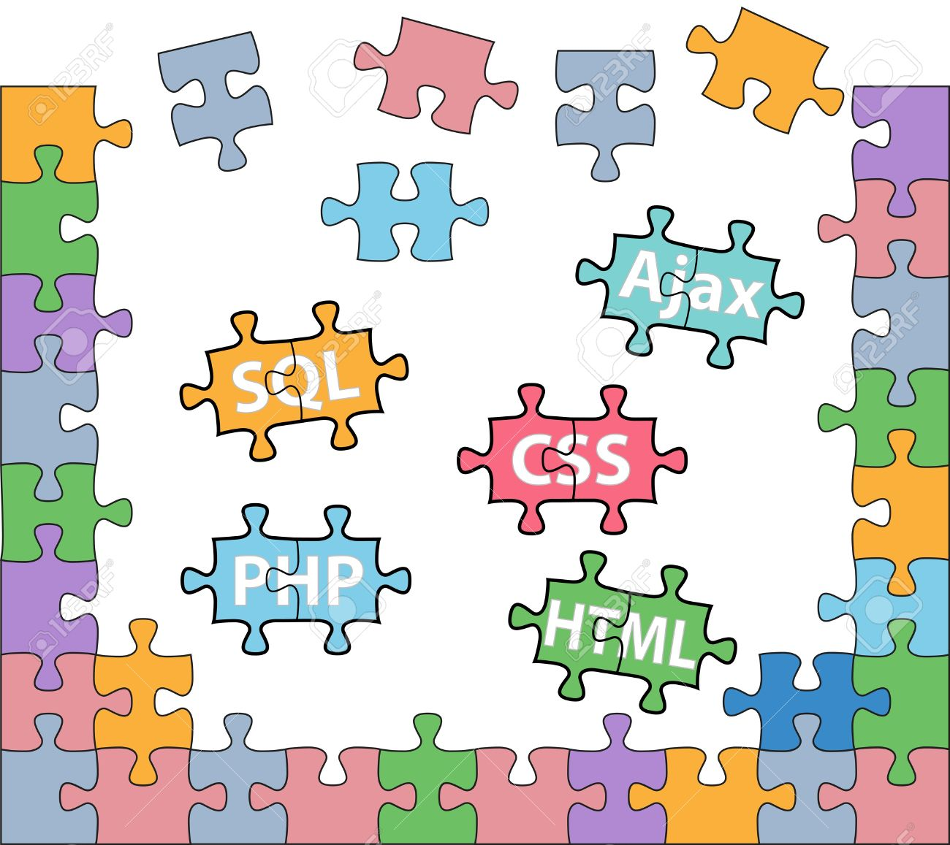
How the pieces fit together
http://www.123rf.com/photo_14491336_html-php-css-sql-jigsaw-puzzle-pieces-in-internet-web-development-solutions.html

Slide 41
HTTP
HTML
Express
Data JSON, XML,…
Queries (SQL)
CSS
APIs
API
Node.js
Results (data)
JS
Resources HTML
CSS
JavaScript …
Relational Not-only relational Object
User
Client
Server
Database
Human
Machine
Machine
Machine

Slide 42
HTML, CSS and JavaScript
HTML has elements
Elements can be referenced by
Element type e.g. <p>
Unique identifier e.g. id=“…”
Attribute class e.g. class=“…”
(Other ways…?)
CSS has rules that
‘Apply’ presentation to referenced elements, through selectors
JavaScript
Gets (and sets) …
Element content
Element attributes & values
… based on references
HTML document as the primary source
Contains HTML (duh)
Contains CSS or reference to CSS
Contains JS or reference to JS

Slide 43
Content vs data
Think of:
Data as what is ‘in’ JavaScript data structures e.g. arrays, objects.
Content as what is ‘in’ the HTML elements.
Data needs to be ‘injected’ into HTML content e.g. JavaScript setter
User entered information needs to be retrieved from the rendered fields on screen e.g. JavaScript ‘getters’
Looking ahead:
Vue helps us do this through two-way binding.
‘Injecting’ data into content; and retrieving content into data

Slide 44
What is a webpage?
Once upon a time:
A valid HTTP request resulted in the download of a webpage comprising:
‘Static’ HTML, CSS, (not even JavaScript) etc, where
Data was embedded as the content of the HTML
You want new data: request a new page.
But now:
A server may send:
Resources: HTML, CSS, JavaScript etc; and separately
Data: JSON, XML; and
The application on the web client injects the data into the HTML etc when needed
Data injection and data retrieval can take place on the client side…
Data injected into HTML, and retrieved from HTML
But still need to be persisted somewhere: locally or on server

Slide 45
Rendering of the page

Slide 46
JavaScript, HTML, CSS, DOM…
Other resources
HTML
DOM
Network
JavaScript
Render
Layout
Paint
CSS
CSSOM
Advice
Put CSS at the top in the HTML HEAD
Put JavaScript at the bottom of the page
https://developer.yahoo.com/performance/rules.html
https://developer.yahoo.com/blogs/ydn/high-performance-sites-importance-front-end-performance-7160.html

Slide 47
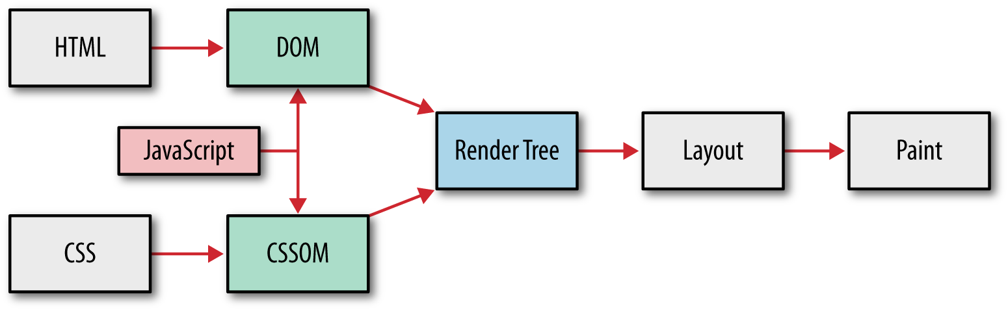
High Performance Browser Networking
http://chimera.labs.oreilly.com/books/1230000000545/ch10.html
Notes:
(From: https://developer.mozilla.org/en-US/docs/Learn/CSS/Introduction_to_CSS/How_CSS_works)
When a browser displays a document, it must combine the document's content with its style information. It processes the document in two stages:
The browser converts HTML and CSS into the DOM (Document Object Model). The DOM represents the document in the computer's memory. It combines the document's content with its style.
The browser displays the contents of the DOM.
A DOM has a tree-like structure. Each element, attribute and piece of text in the markup language becomes a DOM node in the tree structure. The nodes are defined by their relationship to other DOM nodes. Some elements are parents of child nodes, and child nodes have siblings.
Understanding the DOM helps you design, debug and maintain your CSS because the DOM is where your CSS and the document's content meet up.

Slide 48
Where next?

Slide 49
Where next?
This week: In the lab
Next week: lecture
Introduction to web clients
HTML
CSS
etc
Single Page Applications
Frameworks i.e. Vue.js
Assignment 1 return
Next week: labs
Vue.js

Slide 50
SENG365 Web Computing Architecture: Introduction to web clients
Austen Rainer Course Coordinator austen.rainer@canterbury.ac.nz 202, Erskine Building

Slide 51
Other material

Slide 52
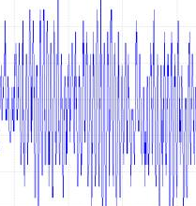
HTTP client (browser)
Internet
HTTP server + stuff
JSON | XML | etc
HTTP
Largely standardised across browsers
Diversity of technologies here
HTML + CSS
DOM + CSSOM
HTTP server (Apache)
Libraries & Frameworks
Scripting engine (PHP)
network layers
JavaScript
Database (MySQL)
APIs e.g. XHR
Platform (Linux)
Other stuff
Device | platform
High volume

Slide 53
‘Injecting’ data into HTML content
Use JavaScript to manipulate the HTML content itself
<p id=”someID”>Oh cruel nothing.</p>
document.getElementById(”someID").innerHTML = ”Hello world!";

